Slide 1
JD+ and R
ESTP Training

Slide 2
1. Main requirements
RJDemetra
Java runtime (>=11)
R (>= 3.1.1)
rJava (>= 0.9-8)
RJDemetra3
Java runtime (>=17.0)
R (>= 3.6.0)
rJava (>= 1.0-6),
RProtoBuf (>= 0.4.17)

Slide 3
2. Technical design (Rjdemetra)
Java
R, native
JTsToolkit.jar
Java
jdr.jar
rJava
R
RJDemetra package
Java
SACruncher
R
R-Studio
…
Java
JDemetra GUI

Slide 4
3. Technical design (Rjdemetra3)
Java
R, native
demetra-xxx.jar
Java
Demetra-xxx-r.jar
rJava,
RProtobuf
R
RJD3xxx package
R
R-Studio
…
Java
JDemetra GUI

Slide 5
4. Rjdemetra3: Overview
rjd3highfreq
rjd3tramoseats
rjd3x13
rjd3sts
rjd3toolkit
rjd3providers
rjd3stl
rjd3nowcasting
rjd3bench
RJDemetra3
rjd3cycle
rjd3revisions
https://github.com/rjdemetra
Design similar to the Java libraries !

Slide 6

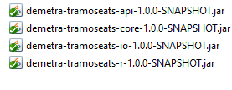
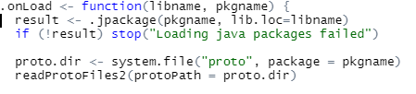
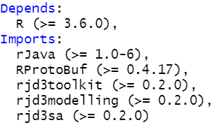
rjd3tramoseats
Proto files
inst
Java package
R files
Description

Slide 7
5. Objectives of R packages
High-level functions with most common results
Many low-level functions
Advanced users
Research
Training
Additional tools

Slide 8


6. Installing the packages
If need be, referencing the correct java runtime (>= 17.0)
Set your JAVA_HOME variable (tip: use the jre provided with JD+)
Install the various packages (internet access needed)
# install.packages("remotes")
remotes::install_github("rjdverse/rjd3toolkit@*release")

Slide 9
6. Installing the packages (cont)
remotes::install_github("rjdverse/rjd3tramoseats@*release")
remotes::install_github("rjdverse/rjd3x13@*release")
remotes::install_github("rjdverse/rjd3providers@*release")
remotes::install_github("rjdverse/rjd3workspace@*release")
remotes::install_github("rjdverse/rjd3filters@*release")
remotes::install_github("rjdverse/rjd3sts@*release")
remotes::install_github("rjdverse/rjd3highfreq@*release")
remotes::install_github("rjdverse/rjd3x11plus@*release")

Slide 10
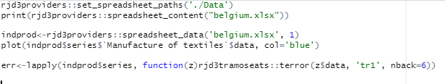
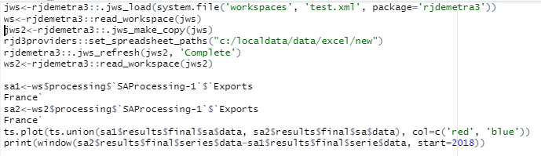
7. Examples
Reading Excel files (JD+-like) and detecting errors
Refreshing a workspace

Slide 11
8. Final remarks
Most features provided in the Java libraries can be called from R
Most tasks can be automated
Many additional tools could be developed in R

